Slide 1

Representation Powers
and
Mandates
RPaM
DIGIT
4th Working Group Meeting
4th April 2019

Slide 2

Agenda
RPaM Working Group Meeting #4
Content
Round Table
Introduction
Open questions
Work done
Testing
Achievements
Considerations for the PoC
Next steps: PoC
Discussion on the open questions
Other questions and suggestions

Slide 3
1
Round
Table

Slide 4


1
Round Table
DIGIT and MS
everis team
European Commission
Miguel Álvarez-Rodríguez (DIGIT, project owner)
Jeroen Rathe (DIGIT, project owner)
Carlos Gómez-Muñoz (DG CNNECT, project owner)
Valentin Mesaros (DIGIT, analyst)
Member States and Stakeholders in previous meetings:
MS →AT, BE, CZ, ES, FI, GR, HU, LU, NL, SI, SK, other?
Stakeholders → SEMPER, TOOP, other?
everis
Virginia Gomáriz (project manager)
Rui Venâncio (client manager)
Enric Staromiejski (eGovernment and interoperability)
Laia Bota (semantics analyst)
Jade Maana (developer)

Slide 5
2
Introduction

Slide 6
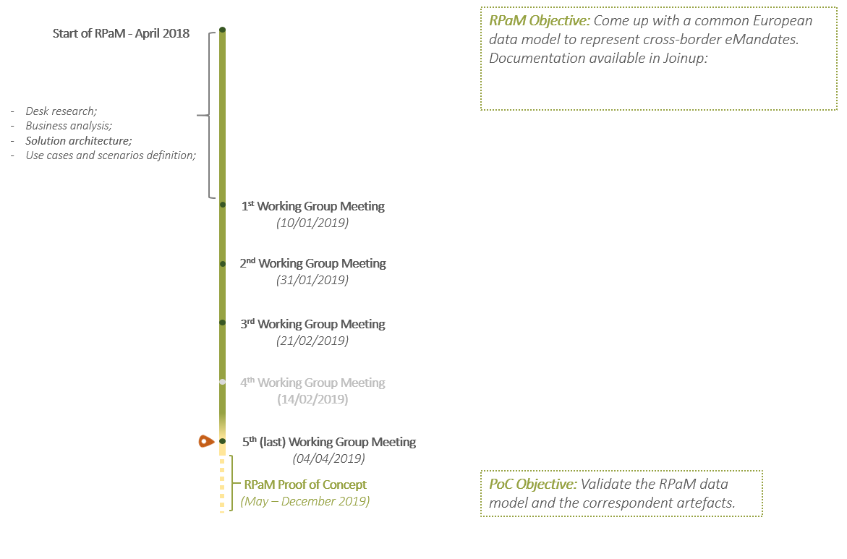
3
Introduction
https://joinup.ec.europa.eu/solution/analysis-and-specifications-cross-border-emandates-system-ec

Slide 7
3
Open Questions

Slide 8
2
Open questions
Do you consider a cross-border and cross-domain electronic RPaM system useful?
Do you have an eMandate system in place?
If Yes, are you considering the integration of RPaM?
If No, would you consider the adoption of RPaM?
Do you foresee systems as mandators or mandatees?
Do you think that the European Commission should provide the support the adoption and integration of RPaM?
What would be the use and value of eSignature in the context of RPaM?
What other initiative would you like ISA to put forward? E.g. support to the mapping between Member States and PAM models, support for testing and deployment…

Slide 9
4
Work
done

Slide 10
4.1
Model stabilisation - Overview
Mapping the MS information Requirements to the RPaM Ontology:
TAXUD is being proposed to be taken on board
Inputs taken from the GitHub issues (16) contributed to improve the ontology, e.g. coRepresentation.
Conversations with Member States clarified concepts and the glossary.
Conceptual Model, the following diagrams have evolved:
Mandate
eMandate Request
eMandate Response
Agent
Criterion and Evidence model
OWL-DL-Turtle syntax-binding:
Re-factoring of the T-Box
Example datasets
Example SPARQL queries
https://github.com/everis-rpam/RPaM-Ontology/tree/v1.1.0/02-Conceptual_Data_Model/MS-RPaM
https://github.com/everis-rpam/RPaM-Ontology/wiki/Conceptual-Model-v1.1
https://github.com/everis-rpam/RPaM-Ontology

Slide 11
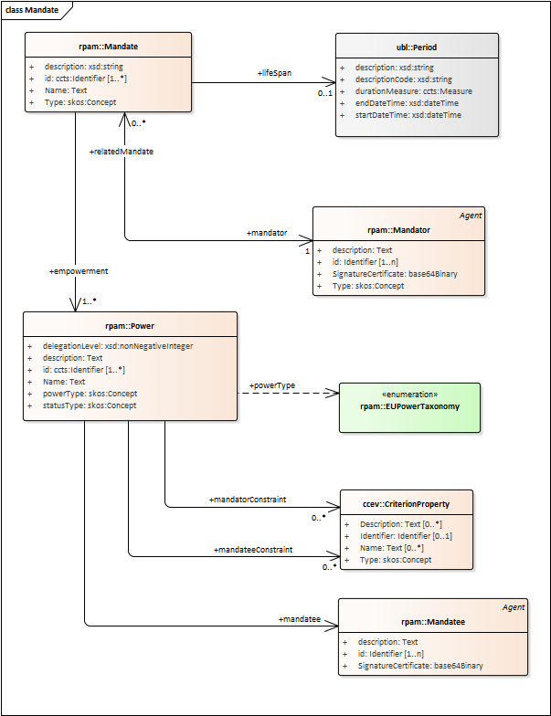
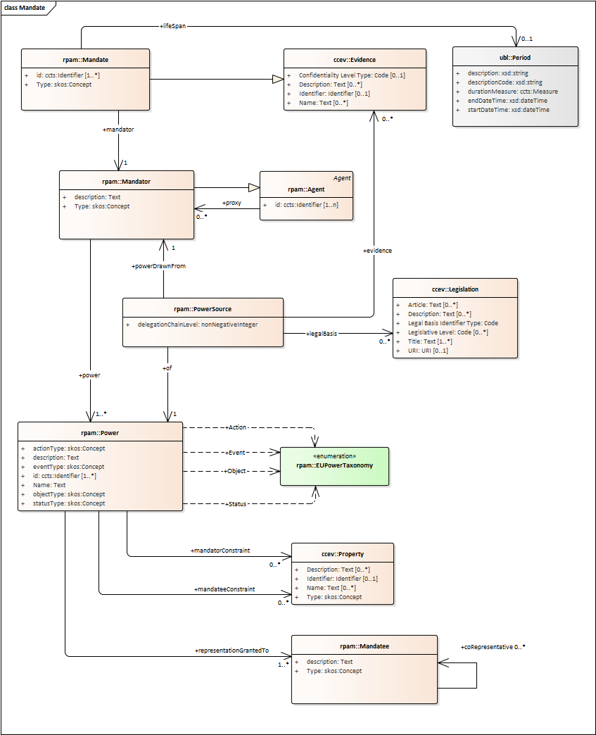
4.2
Model stabilisation - Mandate
REMINDER
CURRENT
EAP file
https://github.com/everis-rpam/RPaM-Ontology/blob/v1.1.0/02-Conceptual_Data_Model/RPaM.EAP

Slide 12
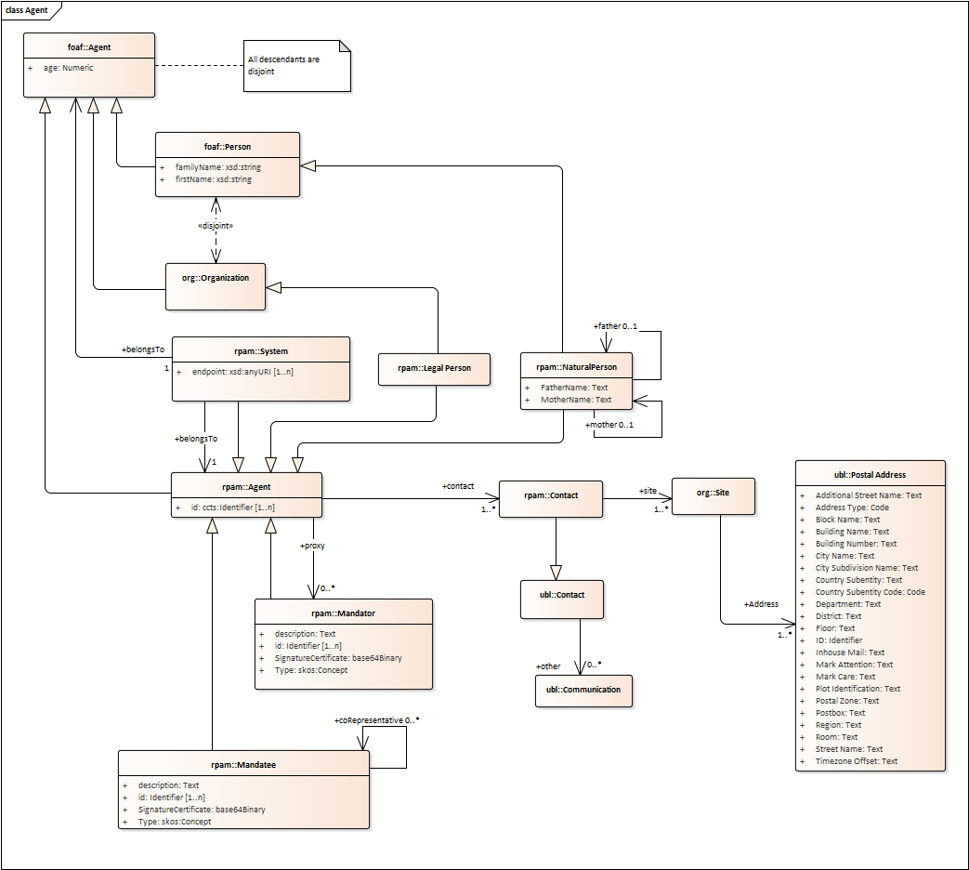
4.3
Model stabilisation - Agent
EAP file
This model is relevant for fundamental definitions. See article Delegation and Revocation of Powers
https://github.com/everis-rpam/RPaM-Ontology/blob/v1.1.0/02-Conceptual_Data_Model/RPaM.EAP

Slide 13
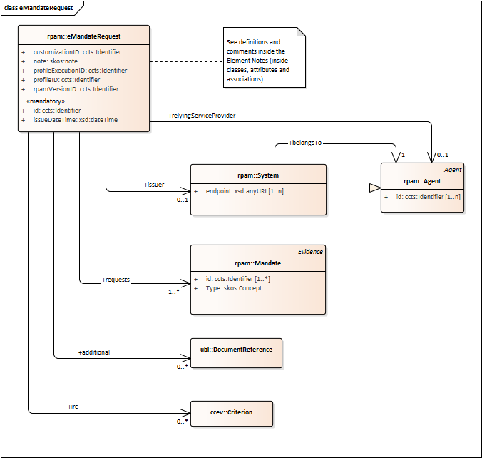
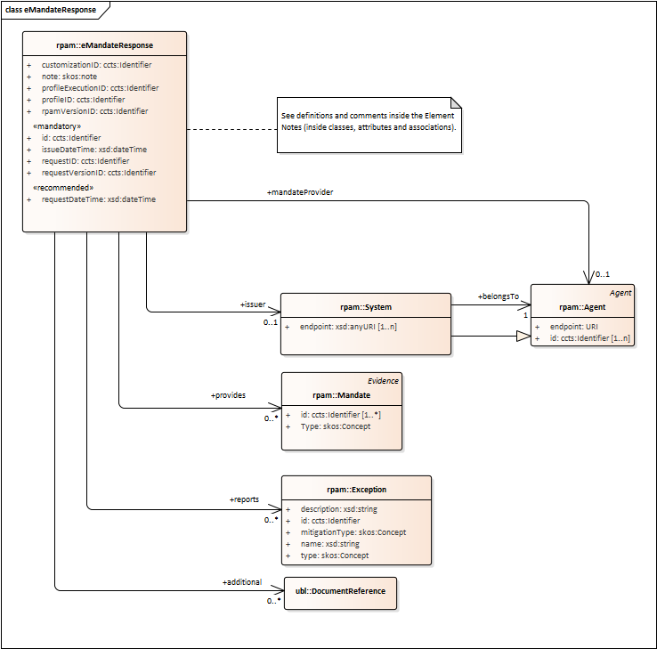
4.4
Model stabilisation – eBusiness Documents
eBusiness Document: a set of interrelated information representing the facts, data, or opinions, in any medium or form, including textual, numerical, graphic, cartographic, narrative, or audio-visual forms that the capability exchanges with other capabilities to support the execution of value streams.
EAP file
https://github.com/everis-rpam/RPaM-Ontology/blob/v1.1.0/02-Conceptual_Data_Model/RPaM.EAP

Slide 14
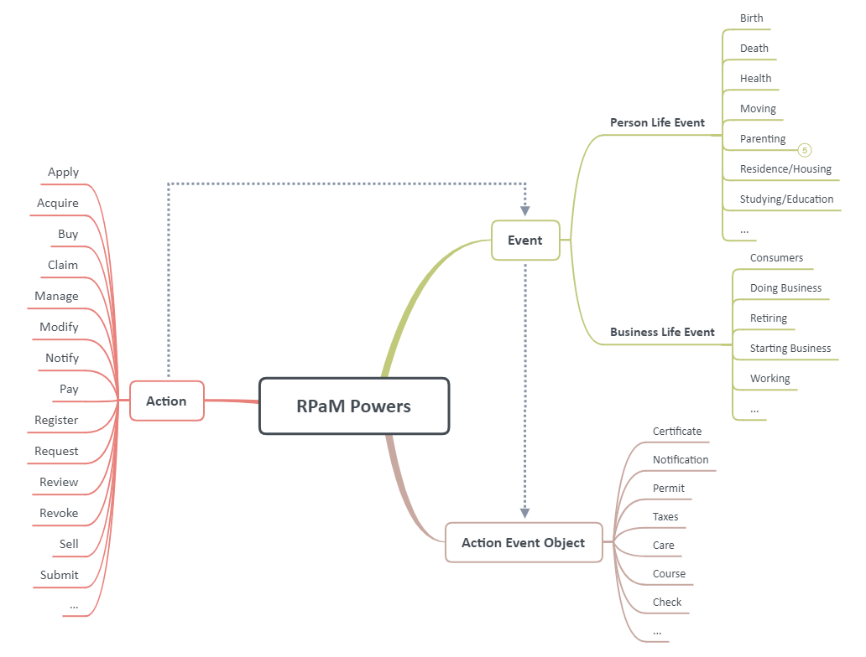
4.5
Enrichment of the EU Power Taxonomy Proposal

Slide 15
4.6
Business rules
In the context of RPAM, business rules must be considered at data validation time. Examples:
Delegations should not reach the level 3.
Periods must check that the end date is not lesser than the start date.
Periods must check the non-co-occurrence of the end-date and the duration measure.
When a mandatee delegates to another mandatee, the the mandator and all the previous mandatees must be notified.
A mandate must have one and only mandator.
A mandate, power, mandator and mandatee must have an unique identifier.
At least one instance of mandate or exception must be present in an eMandate Response.

Slide 16
5
Testing

Slide 17
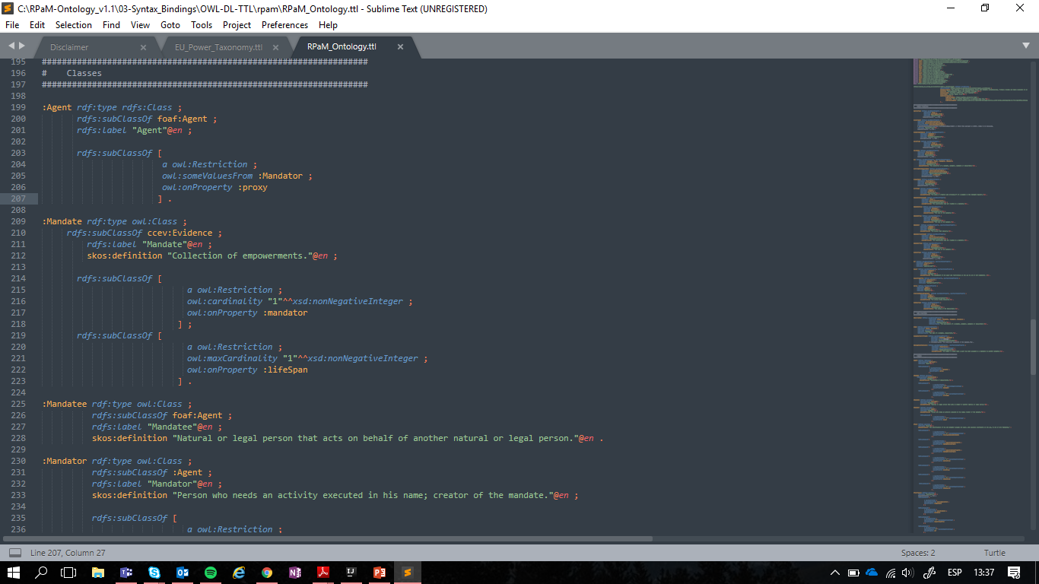
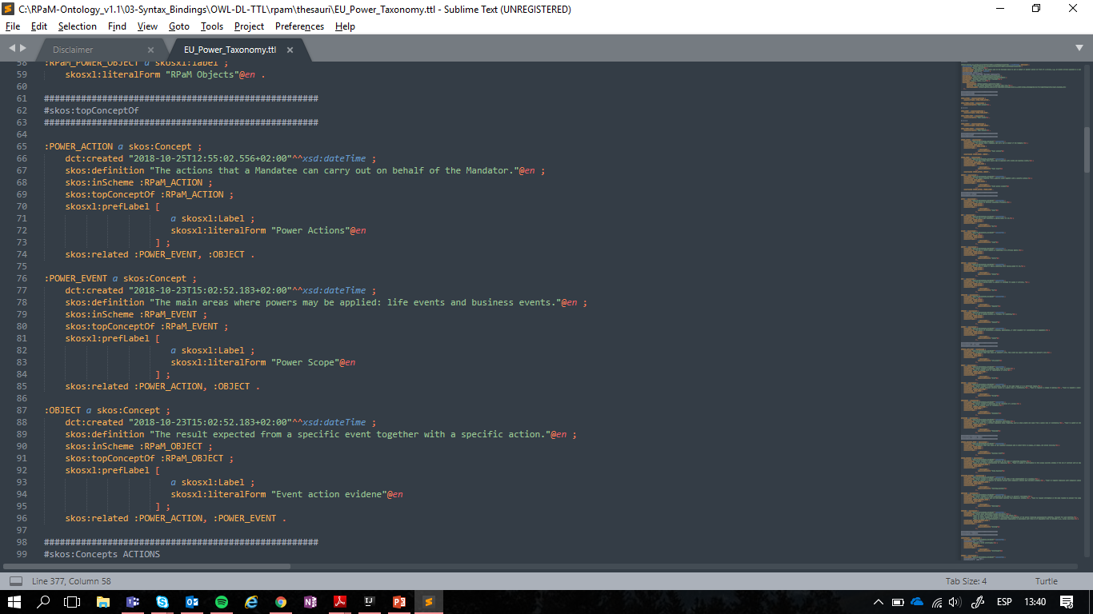
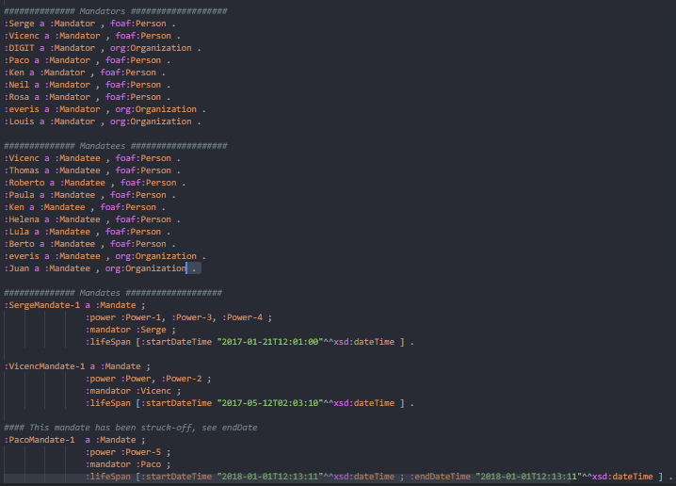
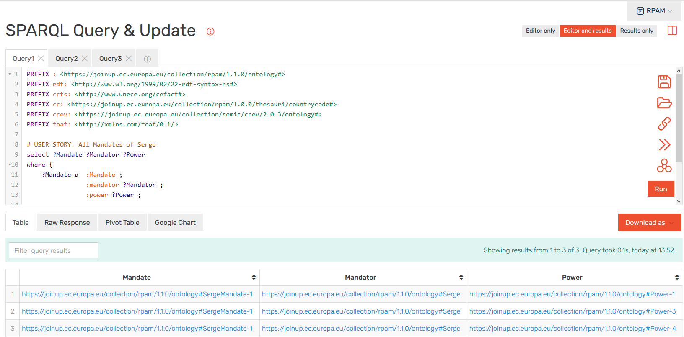
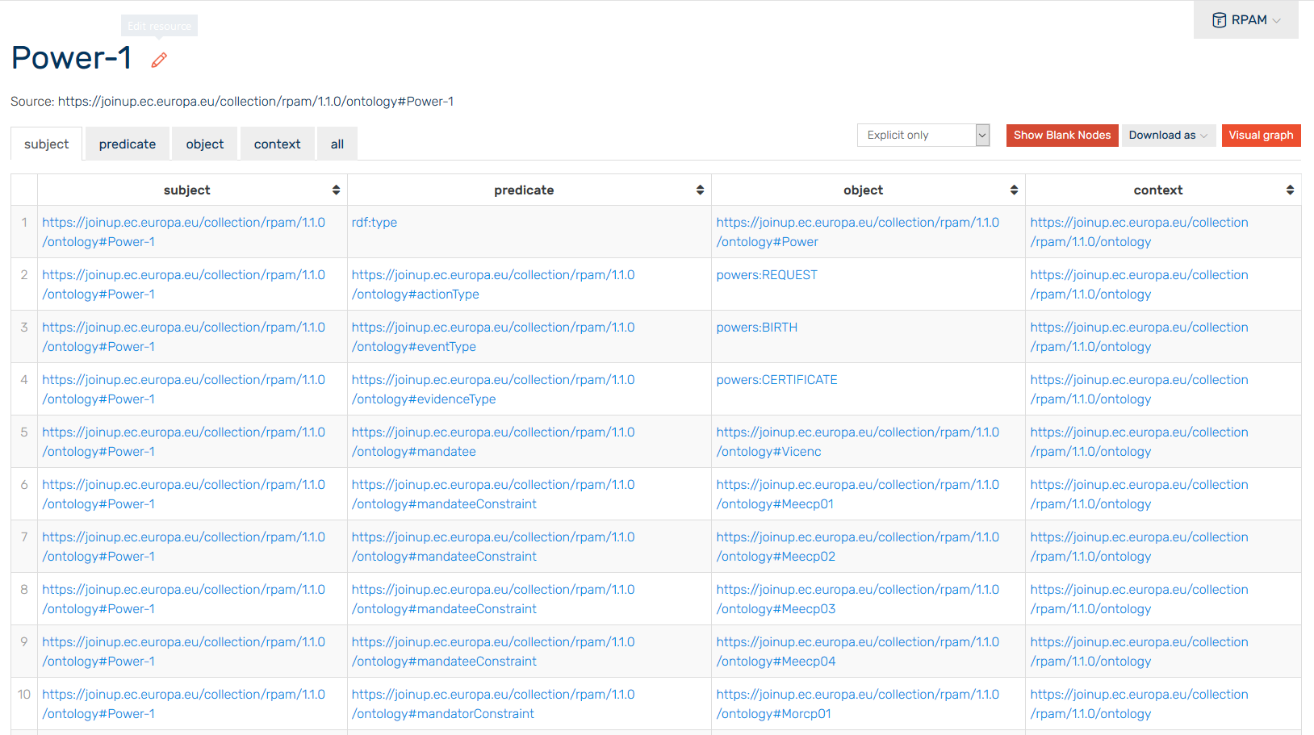
5.1
Testing materials
RPaM Ontology
EU Powers Taxonomy
Dataset example
Graph store
SPARQL Queries
https://github.com/everis-rpam/RPaM-Ontology/tree/v1.1.0/07-Testing

Slide 18
5.2
RPaM Ontology (TTL)
https://github.com/everis-rpam/RPaM-Ontology/tree/v1.1.0/07-Testing

Slide 19
5.3
EU Power Taxonomy (SKOS)
https://github.com/everis-rpam/RPaM-Ontology/tree/v1.1.0/07-Testing

Slide 20
5.4
RPaM Dataset (TTL)
https://github.com/everis-rpam/RPaM-Ontology/tree/v1.1.0/07-Testing

Slide 21
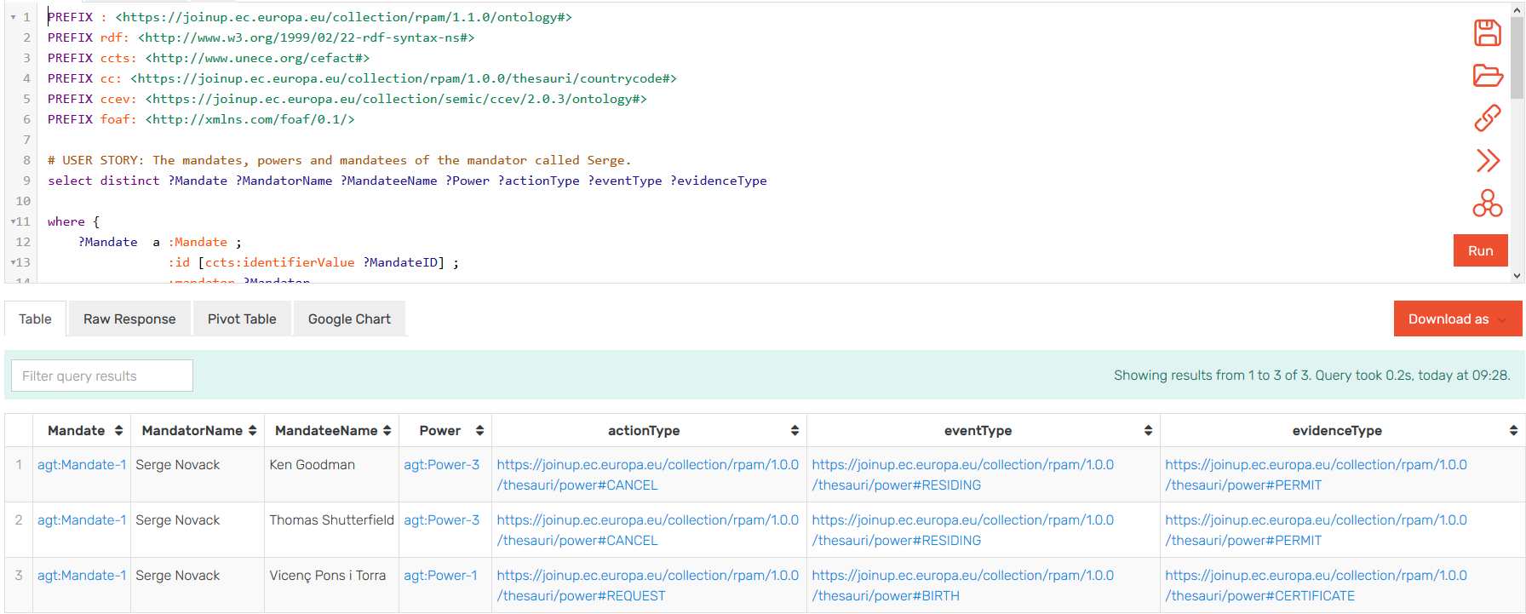
5.5
Testing

Slide 22
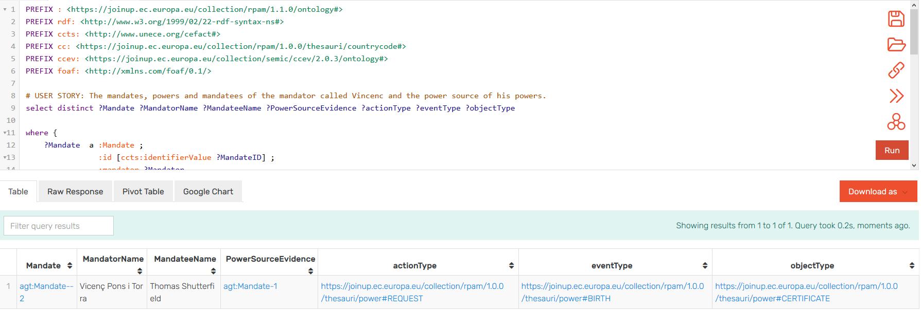
5.5
Testing

Slide 23
6
Achievements

Slide 24
6
Achievements
Stable ontology that meets the member states information requirements identified so far.
A proposal for the design of the EU Power Taxonomy, based on three axes:
Actions
Events
Action Event Targets
A reference implementation of the ontology as an OWL-DL syntax.
eAuthorisation criteria model and samples for service-specific requirements.
Power Use Constraints model and samples to check the validity of Powers.
Business rules for data validation in cross-border exchange scenarios .
Business requirements for the definition of organisational interoperability, i.e stakeholders capabilities definition.
Corresponding documentation produced an publicly available.

Slide 25
7
Considerations for the PoC

Slide 26
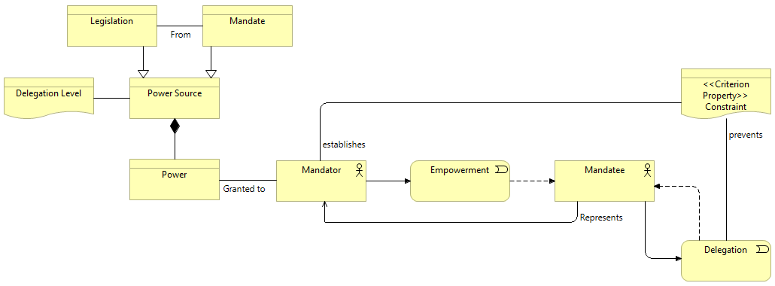
7.2
Delegation system
A delegation allows a mandatee to empower another person on behalf of the represented person.
RPAM Ontology delegation concepts:
The delegation level: The number of times the power has been delegated.
The delegation constraint: Power Use Constraint allowing the mandator, if needed, to allow or restrict the delegation of the power to another mandatee.
See Article: https://github.com/everis-rpam/RPaM-Ontology/wiki/Delegation-and-revocation-of-powers

Slide 27
7.1
Harmonisation of public services
Ongoing work the harmonisation of public services and RPAM:
The current development by the EU Catalogue of Services.
The RPAM definition of a harmonised service.
The RPAM eAuthorisation Criterion approach on the EU Catalogue of Services.
Synergies with the Single Digital Gateway Regulation and Portal.
In regards to the RPaM Ontology, we state that two or more services are harmonised when 1) they have identical mandatee eAuthorisation criteria, and 2) the responses to these can be conveyed in a mandate.
See Article: https://github.com/everis-rpam/RPaM-Ontology/wiki/Harmonised-services

Slide 28
7.4
Identification Policy
Natural and Legal persons, eiDAS impact on the model, need for a rich Identifier data component (Extension of the ISO 15000-5:2014 CCTS), Assurance level.
Mandate identification, rules for a common schemeID,
Agent identification, e.g. Actors and Systems; e.g. Service Provider and eMandate Registry schemeIDs
Other objects that need specific schemeIDs; e.g. Legislation could use ELI.

Slide 29
8
Next steps - PoC

Slide 30
8.1
Next steps - Proof of Concept
Objectives
Validate the RPaM artefacts (data model, business rules, constraints…)
Duration
From May 2019 until December 2019
Tasks
Task 1 - Definition of a Proof of Concept (PoC)
Task 2 - Implementation of the PoC artefacts
Task 3 - Implementation of the pilot
Task 4 Testing and documentation
PoC results
Components deployed in the systems of pilot’s participants
RPaM artefacts updated, if required
Technical Specifications of RPaM artefacts
User manual for the installation of the components in production
Conformance testing service within TestBed

Slide 31
9
Discussion on the open questions

Slide 32
9
Discussion on the open questions
Do you consider a cross-border and cross-domain electronic RPaM system useful?
Do you have an eMandate system in place?
If Yes, are you considering the integration of RPaM?
If No, would you consider the adoption of RPaM?
Do you foresee systems as mandators or mandatees?
Do you think that the European Commission should provide the support the adoption and integration of RPaM?
What would be the use and value of eSignature in the context of RPaM?
What other initiative would you like ISA to put forward? E.g. support to the mapping between Member States and PAM models, support for testing and deployment…

